Slide 1
Chapter 5 Discrete-Time System Analysis in the z-Domain
§5-1 Transfer Function Representation
§5-2 Transform of the Input/output Convolution Sum
§5-3 Stability of Discrete-time Systems
§5-4 Frequency Response of Discrete-Time Systems

Slide 2
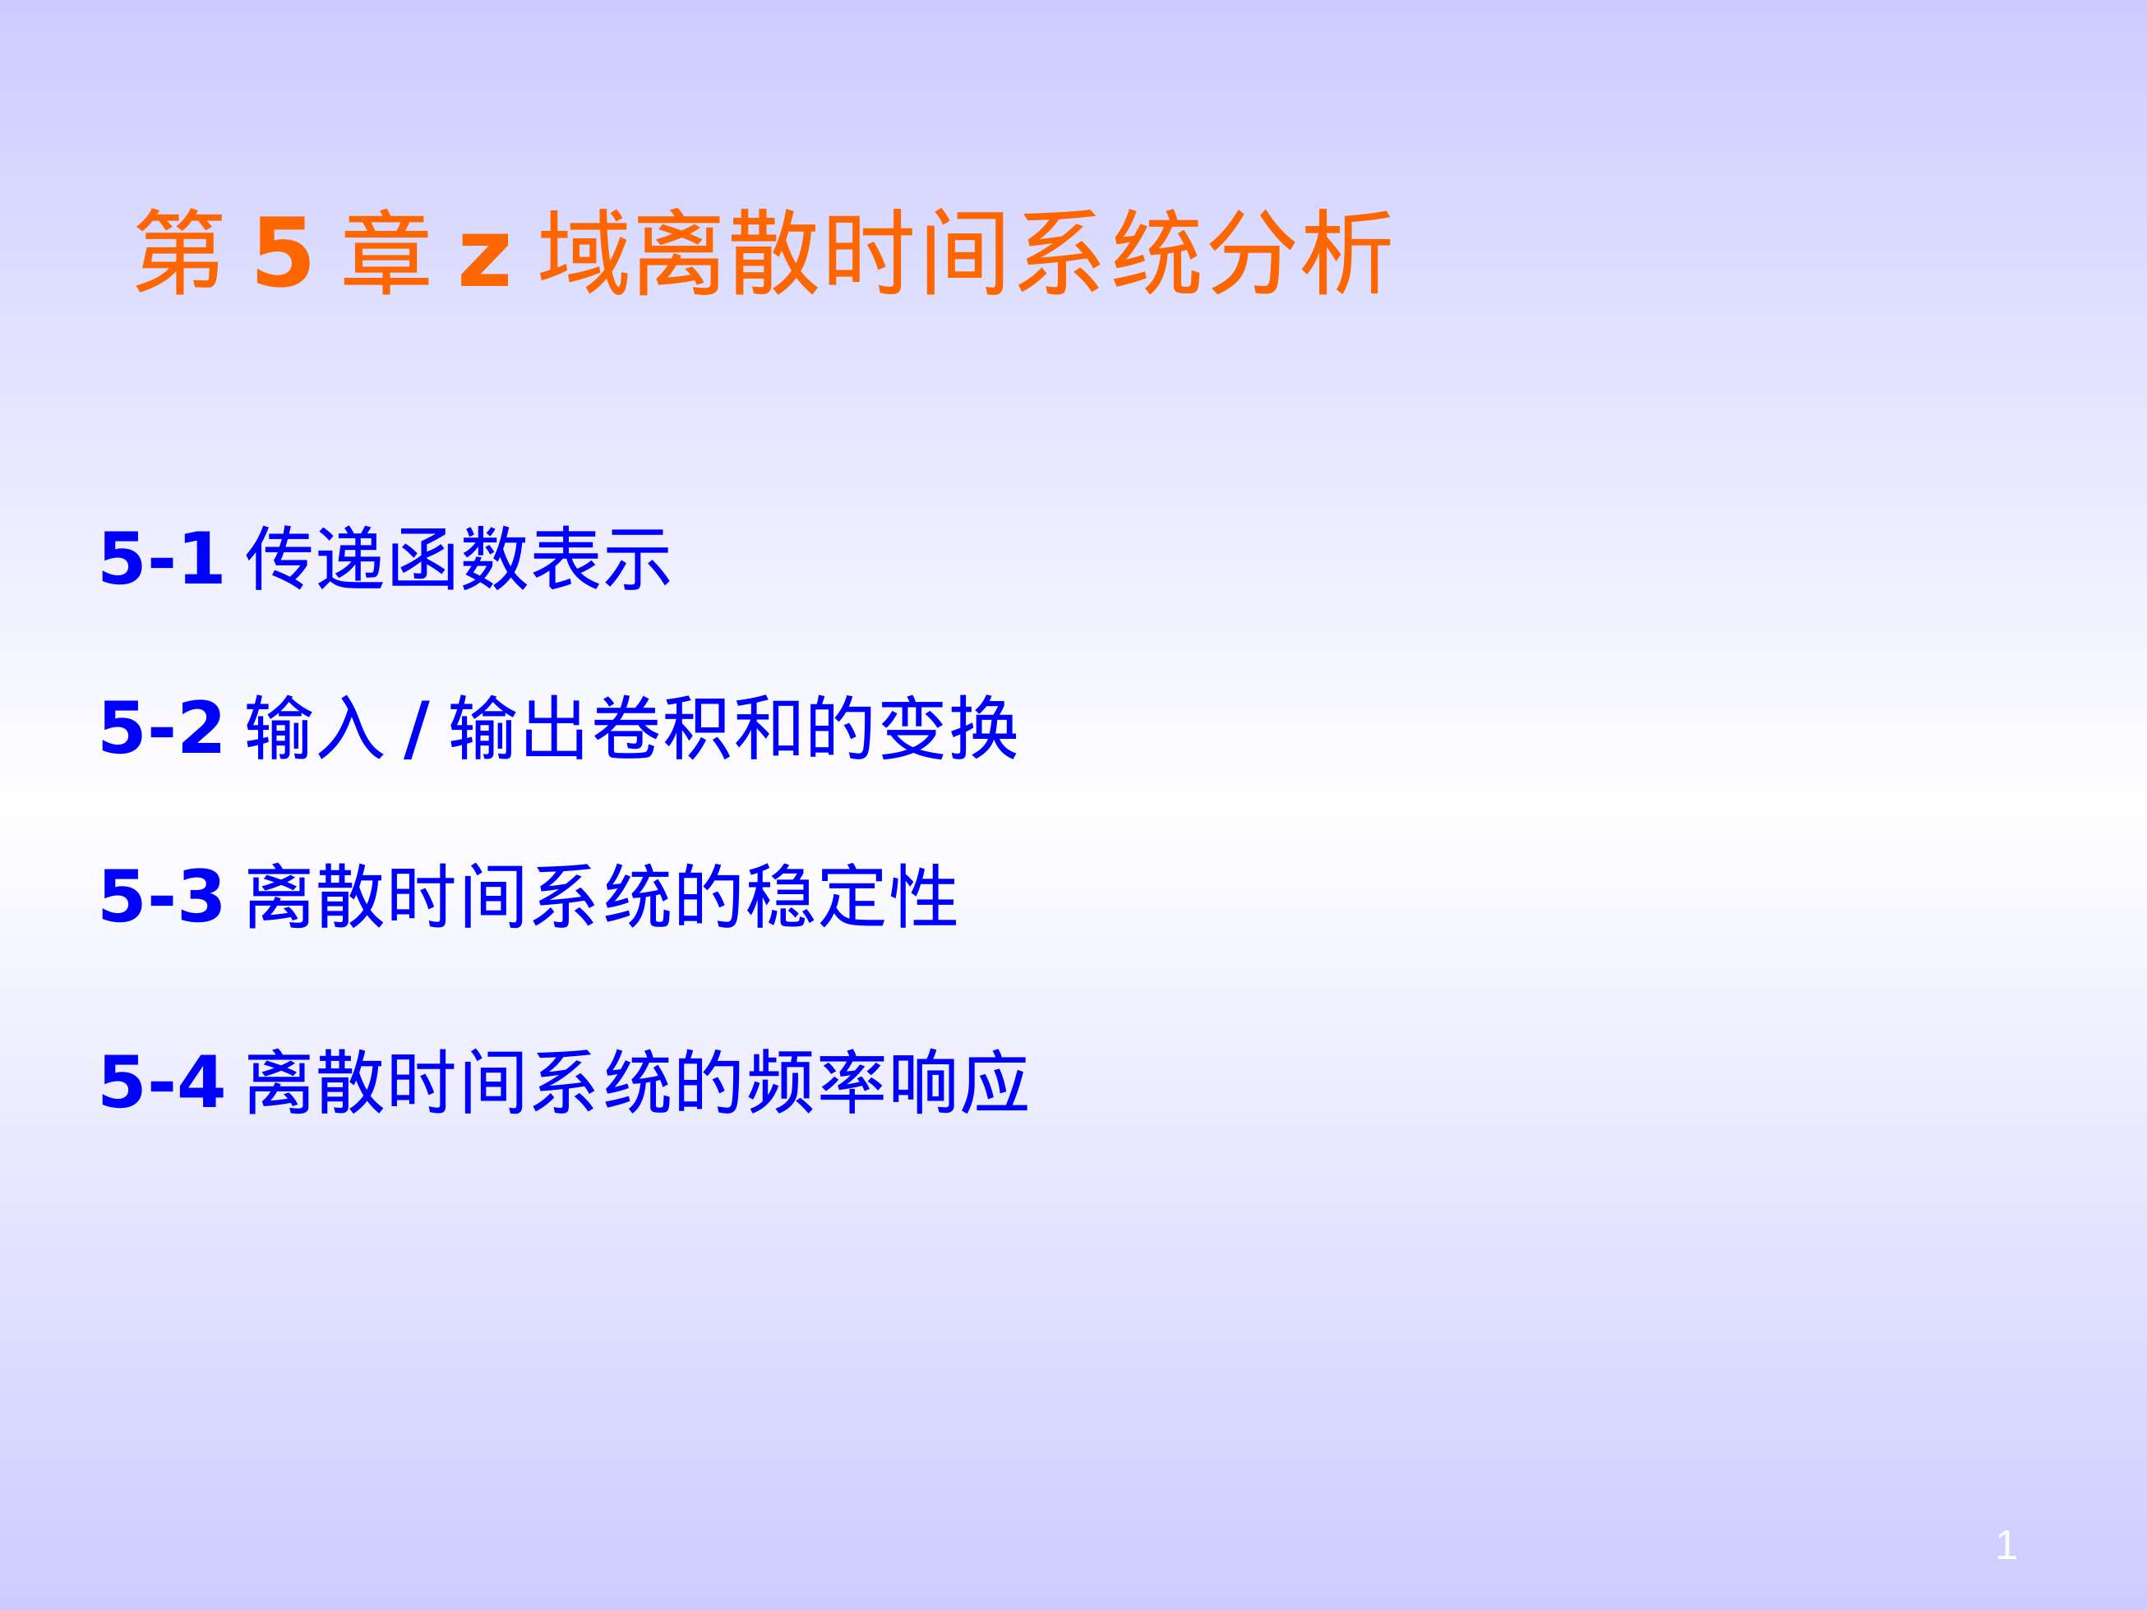

Slide 3
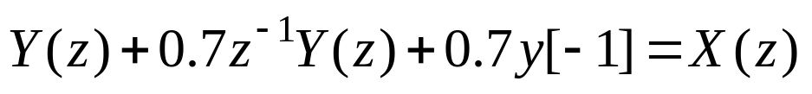
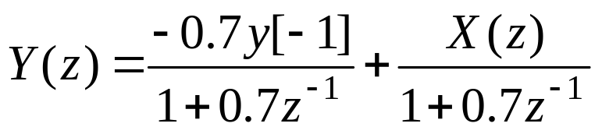
Problems and Solutions
5.1 A system is described by the difference equation
y[n]+0.7y[n−1]=x[n]; y[−1]=1
where the input of the system x[n] =u[n], and y[−1]=1.
(a) Find an analytical expression for y[n].
(b) Determine the transfer function H(z) of the system
Solution:
5.1(a) Taking the z-transform of the difference equation and using the right-shift property give:
Solving for Y(z) gives:

Slide 4
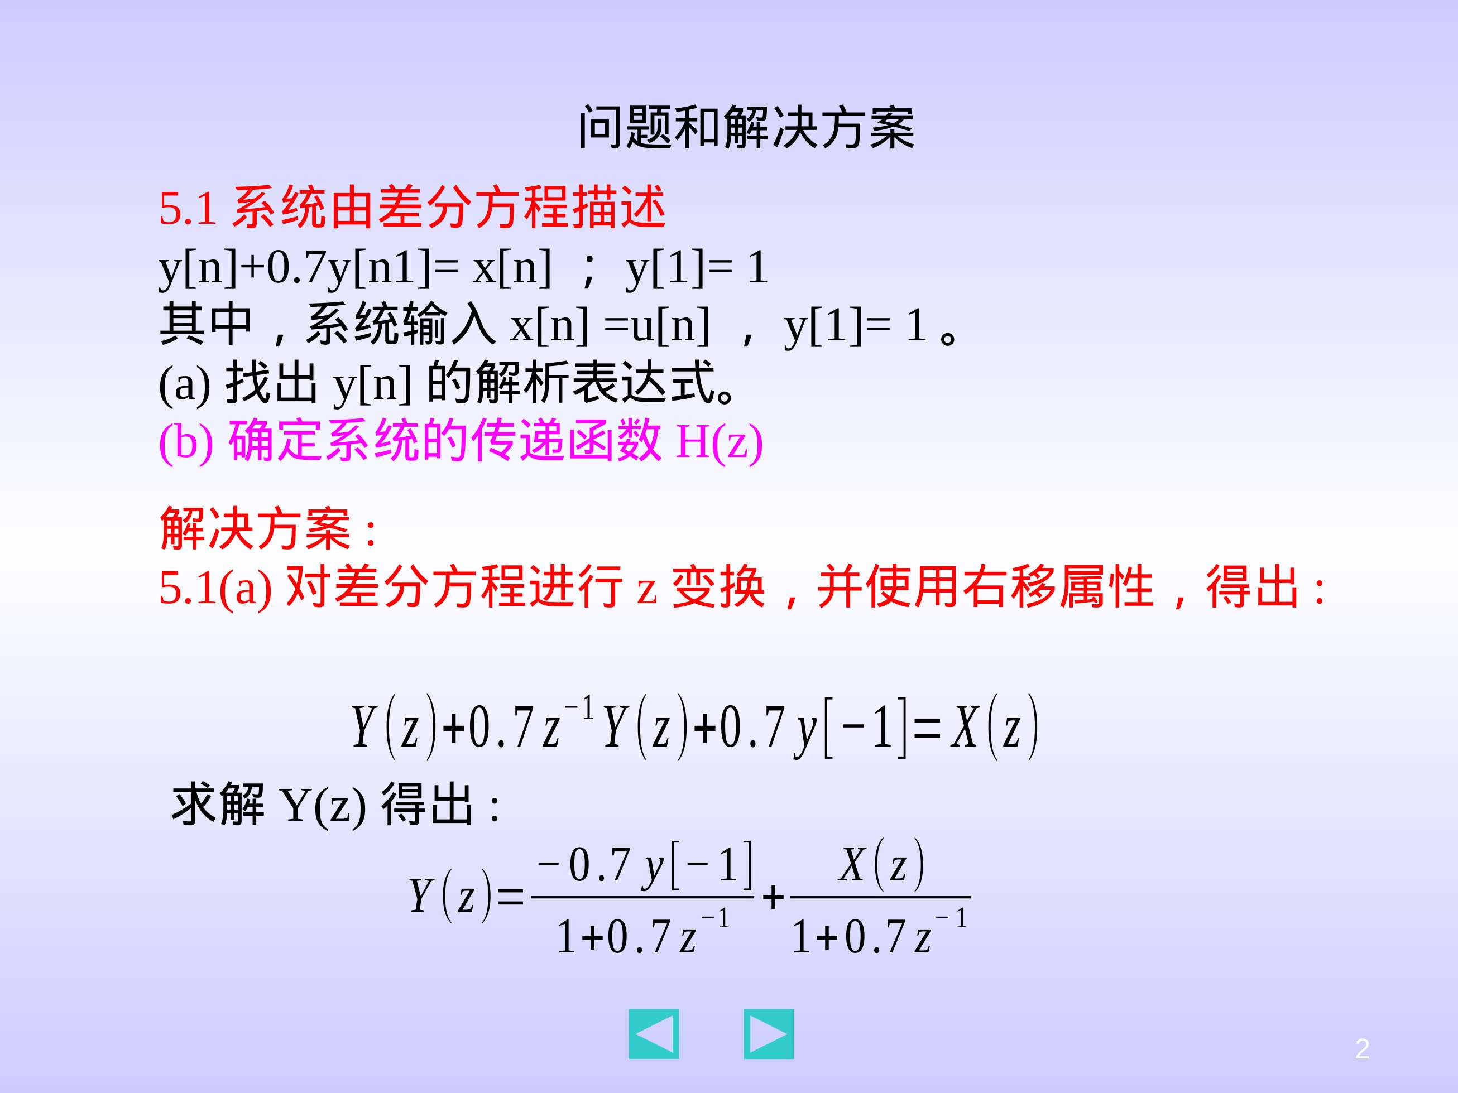

Slide 5
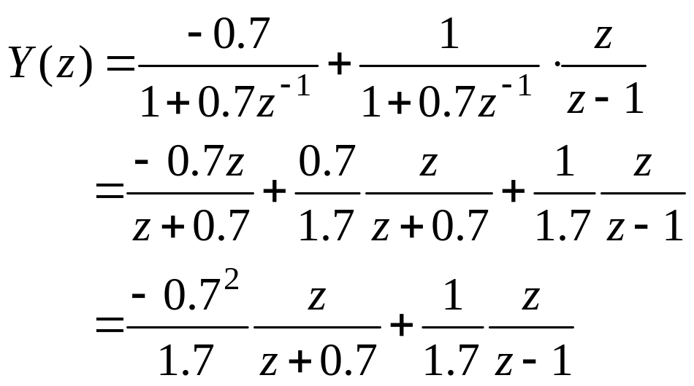
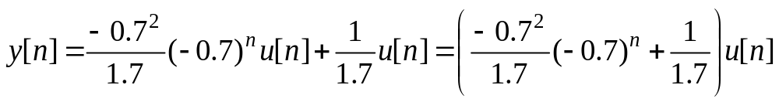
Since y[−1]=1 and X(z)=z/(z−1) (z-transform of u[n]), the above expression becomes:
Taking the inverse z-transform of Y(z) gives:

Slide 6
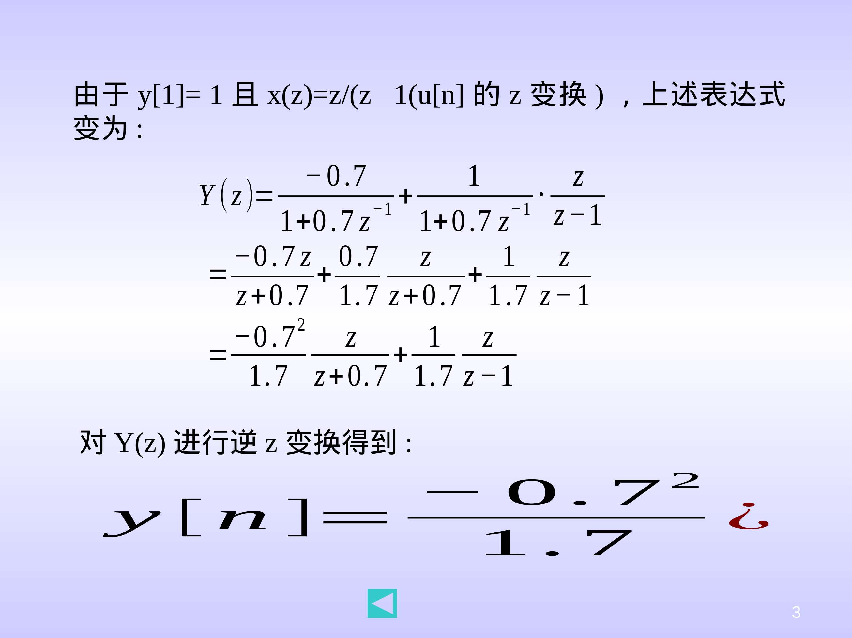
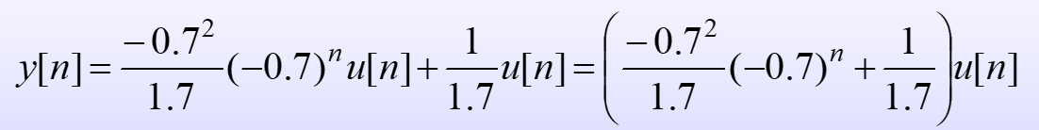

Slide 7
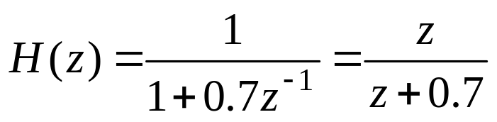
5.1(b) Determine the transfer function H(z) of the system

Slide 8
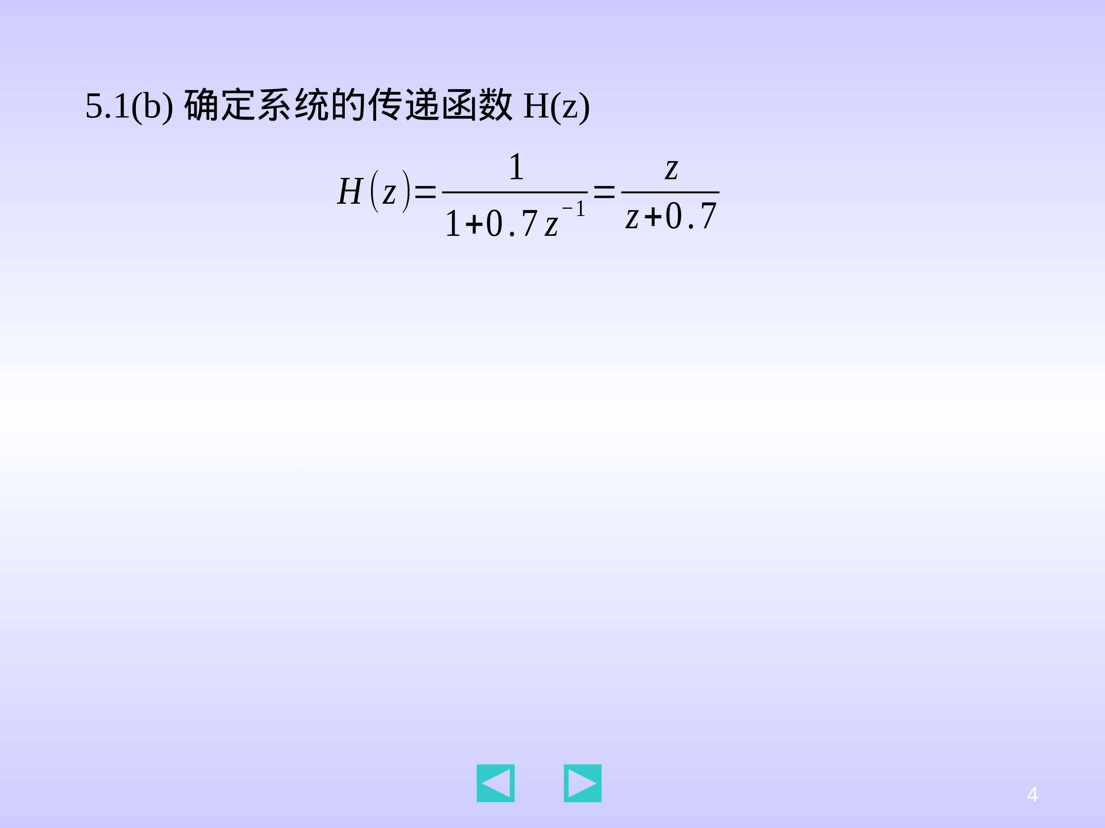

Slide 9
5.2 A system is described by the difference equation
y[n] −0.2y[n−1] −0.8y[n−2]=x[n]
where the input of the system x[n] =0 for all n, and y[−1]=1, y[−2]=1.
(a) Find an analytical expression for y[n].
(b) Determine the transfer function H(z) of the system.
Solution:
5.2(a) Note that x[n] =0 for all n, and y[−1]=1, y[−2]=1. Taking the z-transform of the difference equation and using the right-shift property give:
Solving for Y(z) gives:

Slide 10
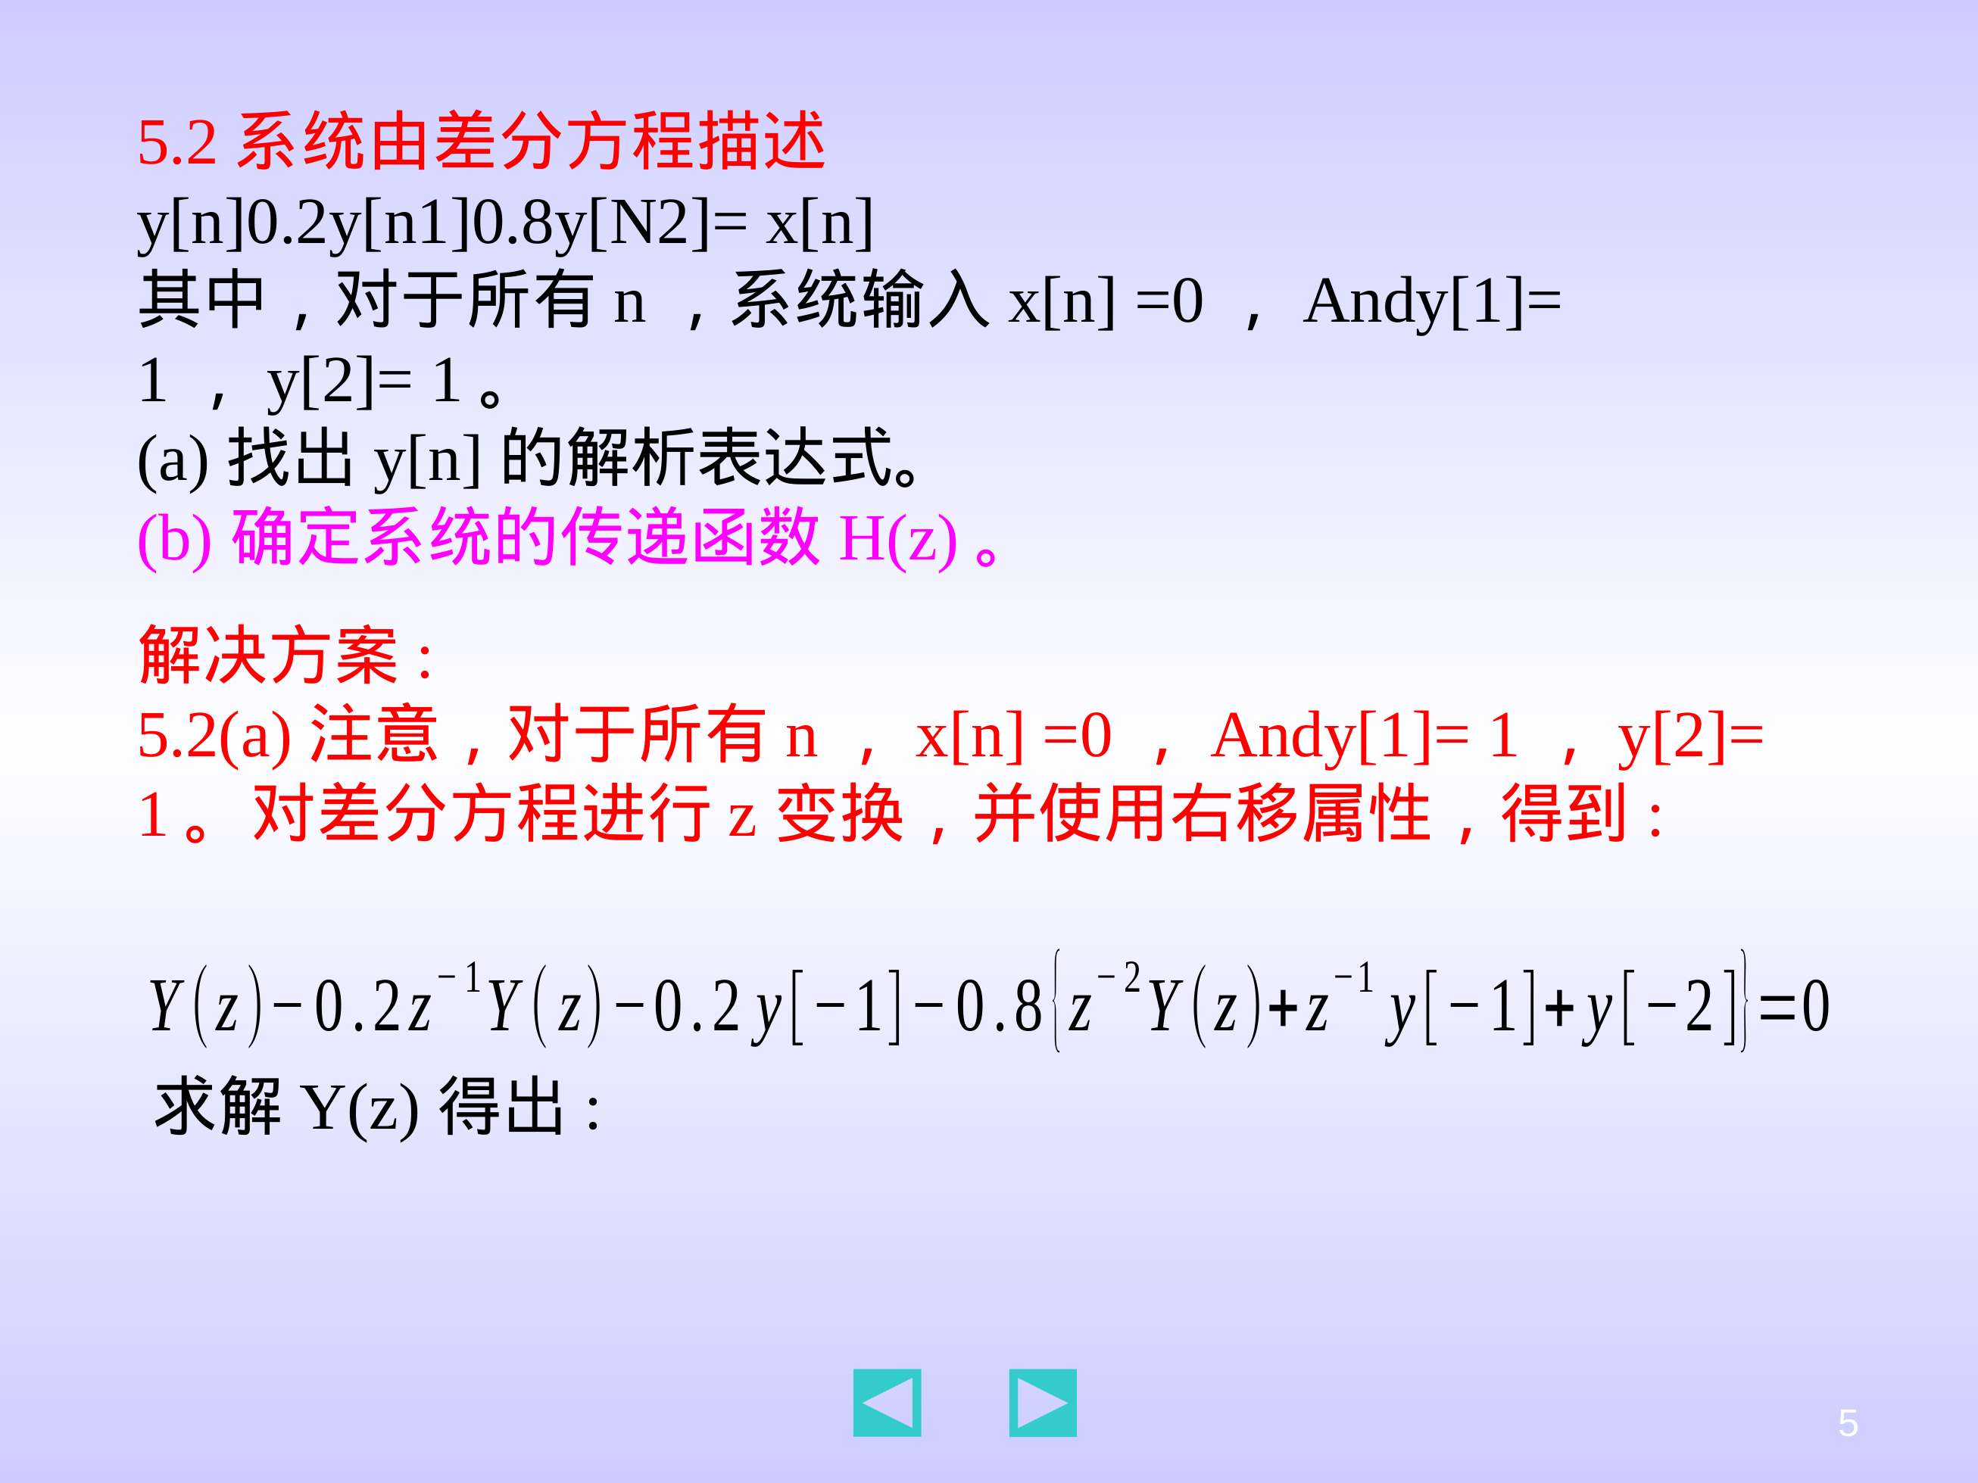

Slide 11
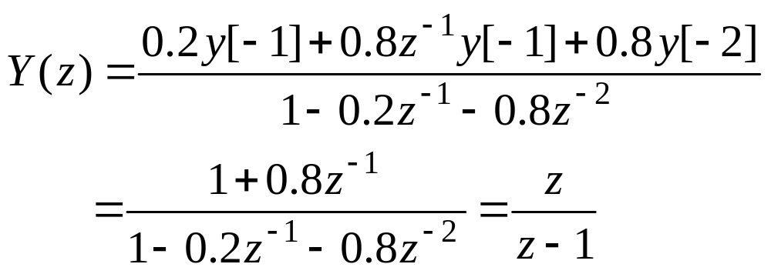
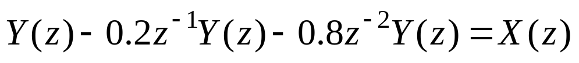
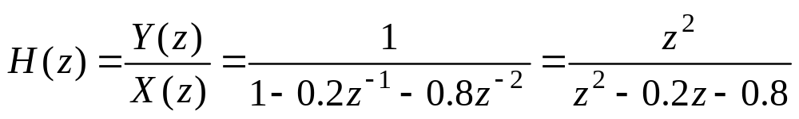
Taking the inverse z-transform of Y(z) gives:
y[n]=u[n]
5.2(b) Taking the z-transform of the difference equation with y[−1]=y[−2]=0 gives:
And thus

Slide 12
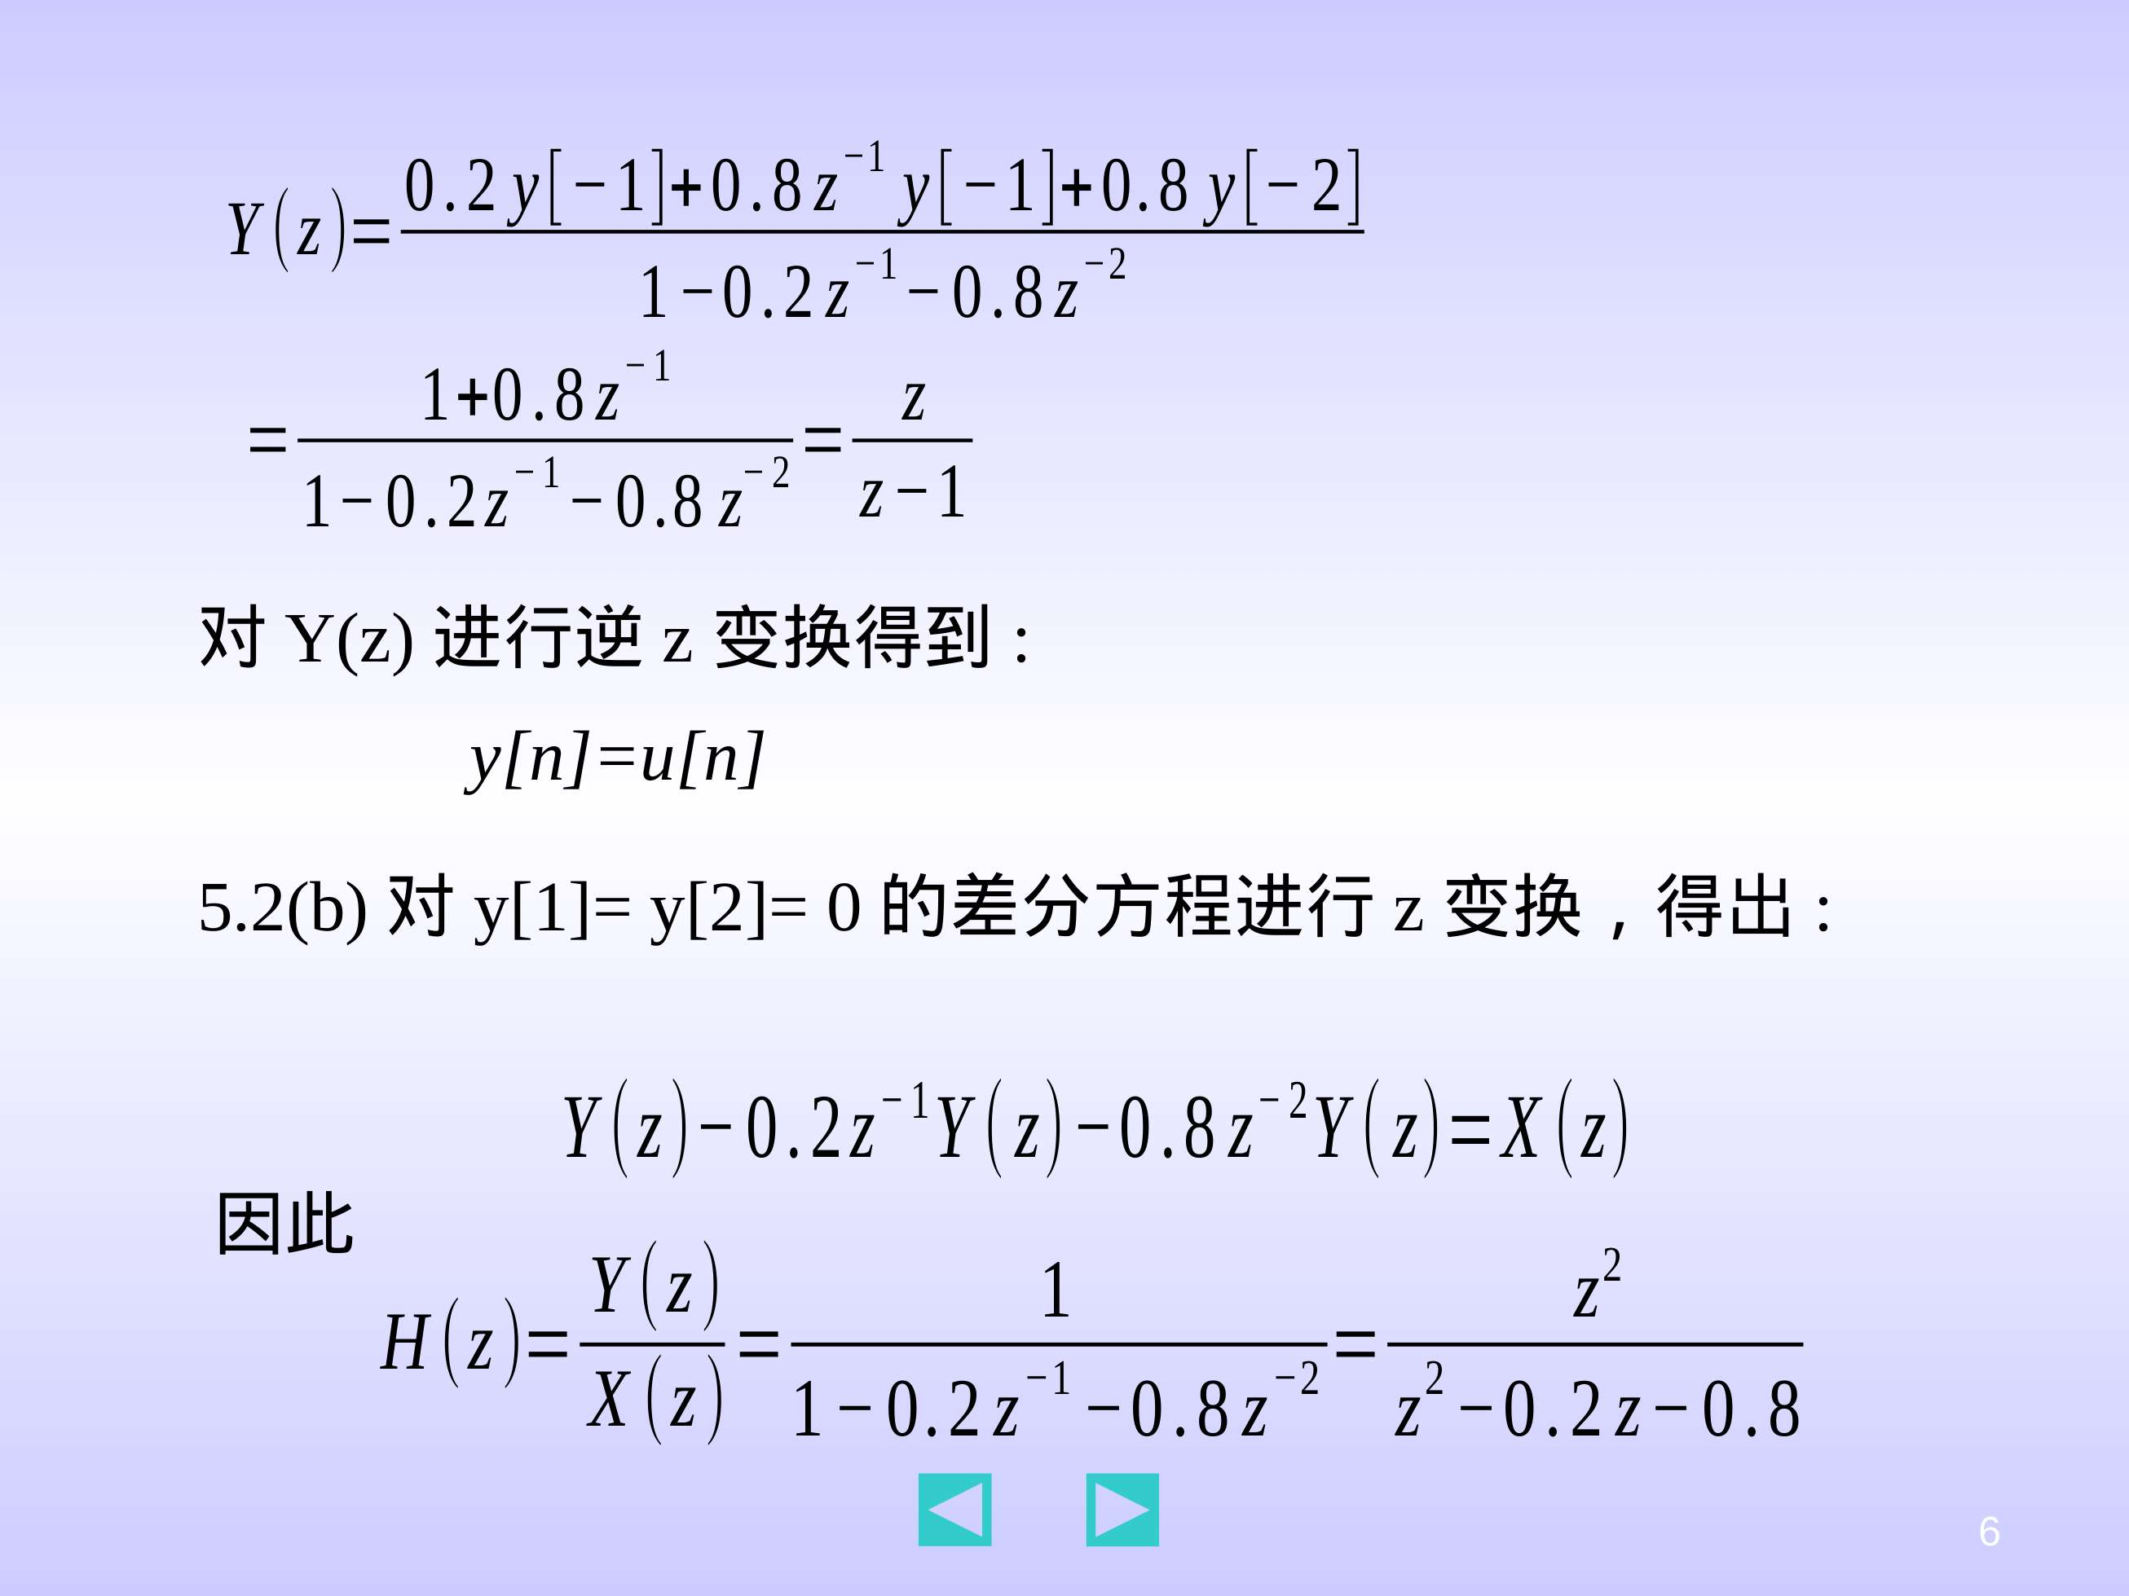

Slide 13
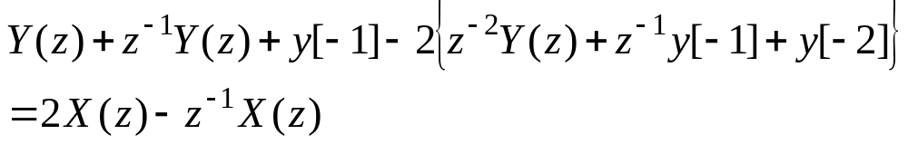
5.3 A linear time-invariant discrete-time system is given by the input/output difference equation
y[n]+y[n−1] −2y[n−2]=2x[n] −x[n−1]
Find an input x[n] with x[n]=0 for n<0 that gives the output response y[n]= 2(u[n] −u[n−3]) with initial conditions y[−2]=2, y[−1]=0.
Solution:
Taking the z-transform of the difference equation with x[−1]=0 and using the right-shift property give:
Solving for X(z) gives:

Slide 14
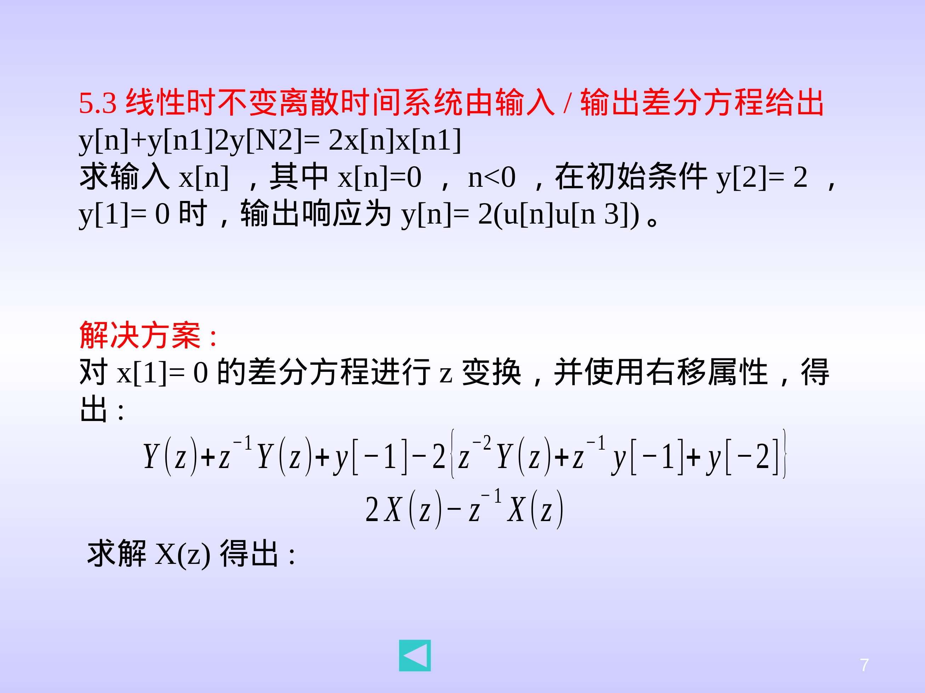

Slide 15
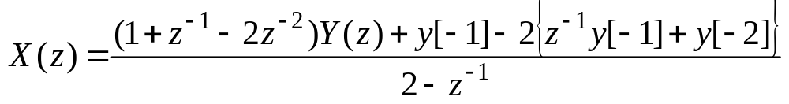
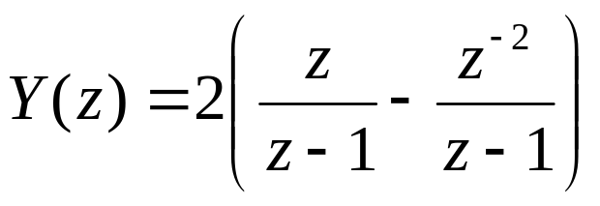
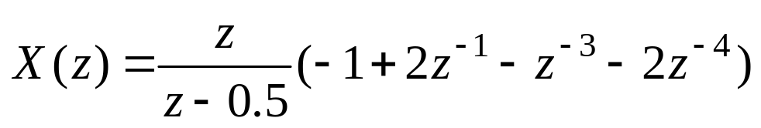
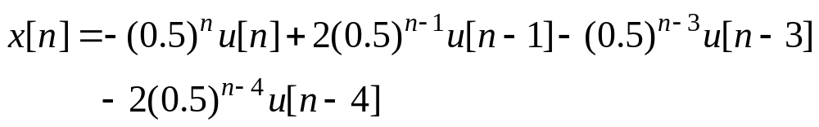
Since y[n]= 2(u[n] −u[n−3]) with initial conditions y[−2]=2, y[−1]=0, the z-transform of y[n] is:
and thus
Taking the inverse z-transform of X(z) gives:

Slide 16
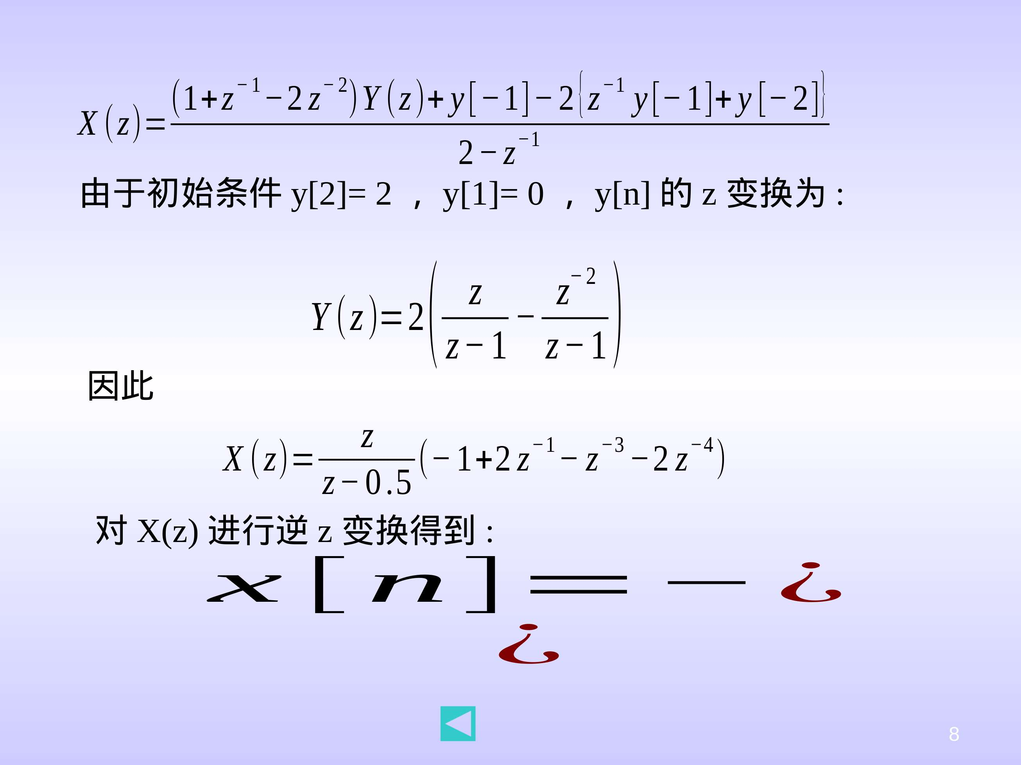
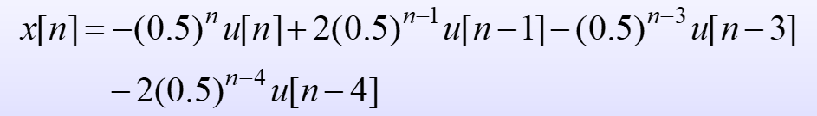

Slide 17
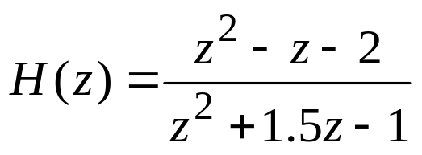
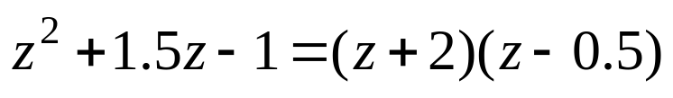


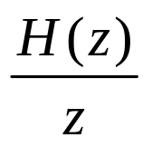
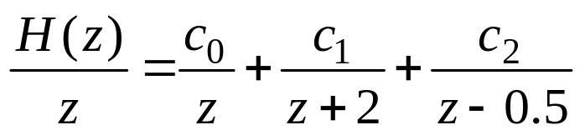
5.4 A linear time-invariant discrete-time system has transfer function
(a) Compute the unit-pulse response h[n] for all n≥0.
(b) Compute the step response y[n] for all n≥0.
(c) Determine if the system is stable, marginally stable, or unstable.
Solution:
5.4(a) Since
the roots of are:
Then expanding gives:

Slide 18
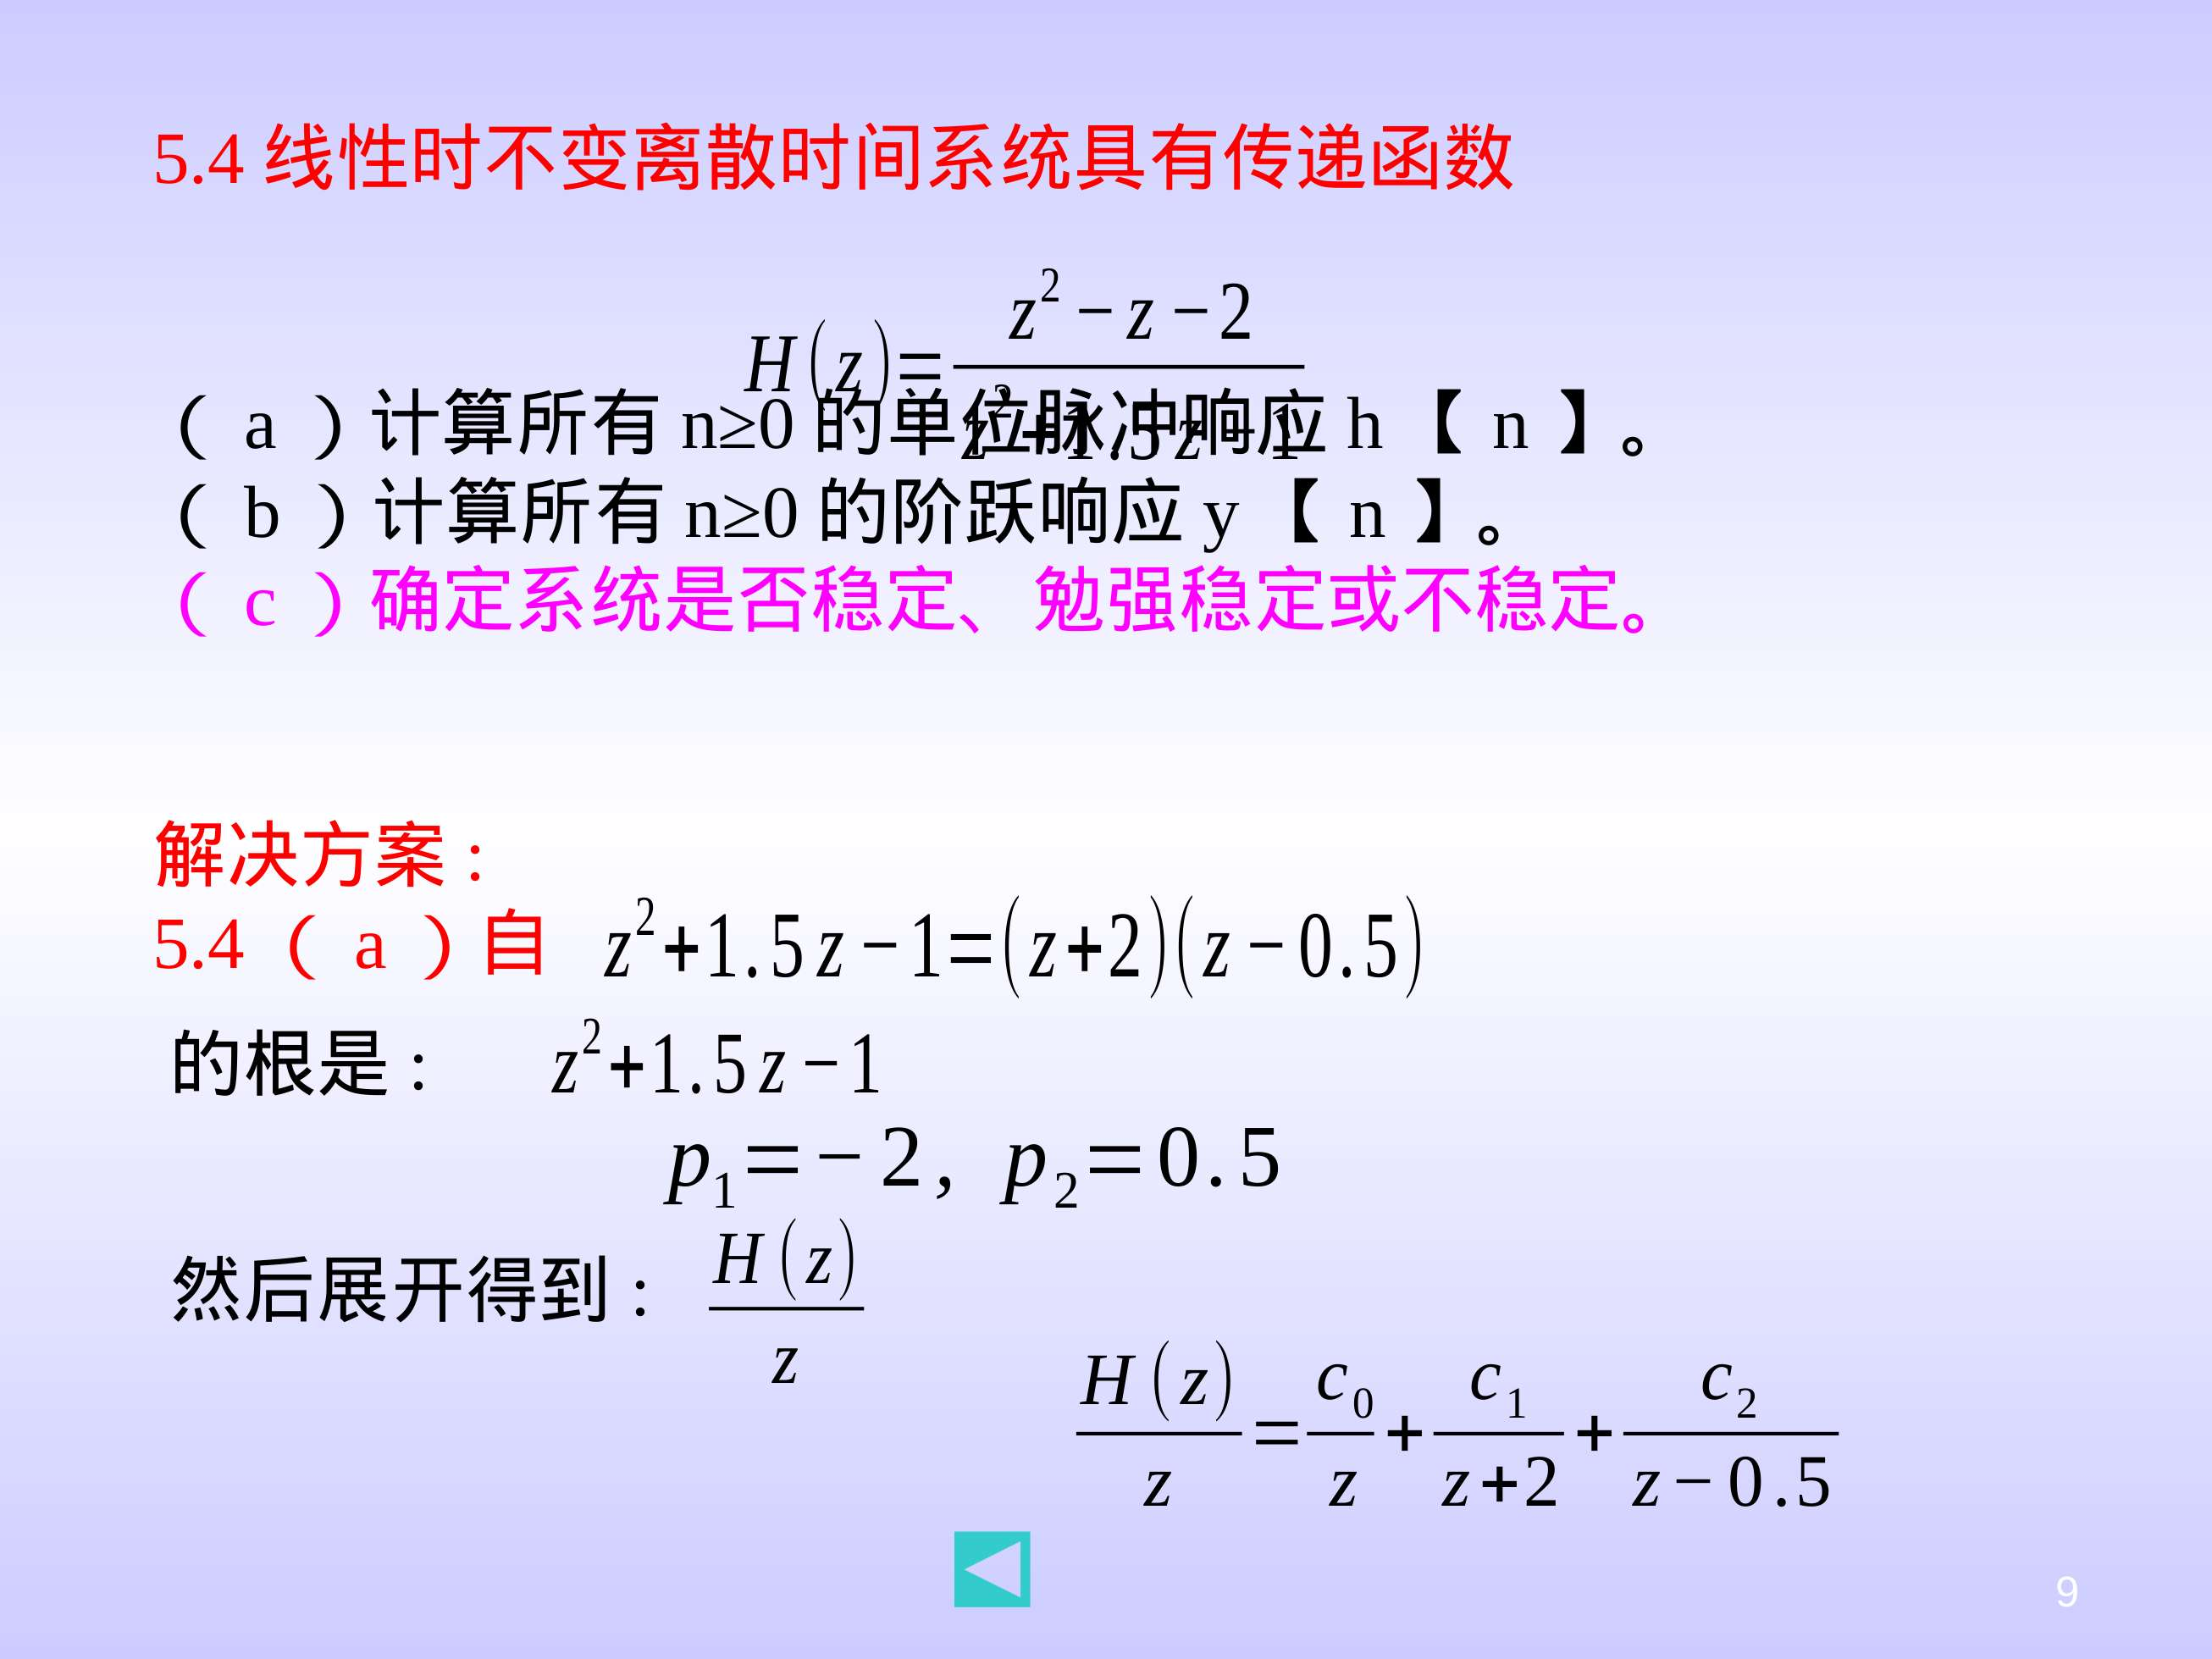

Slide 19
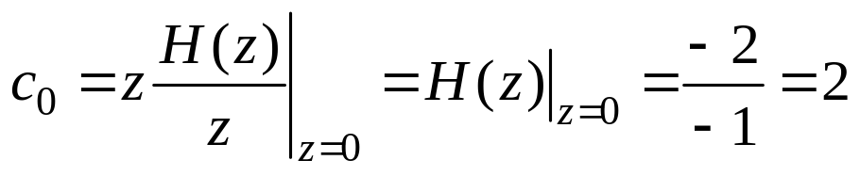
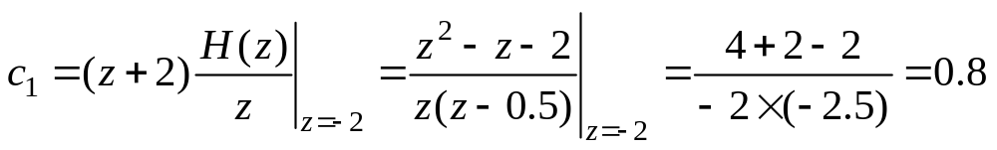
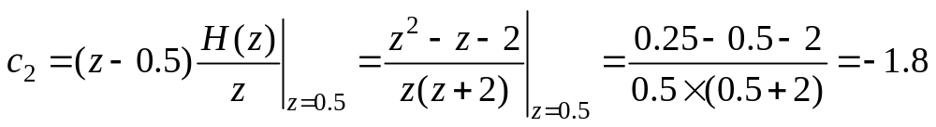
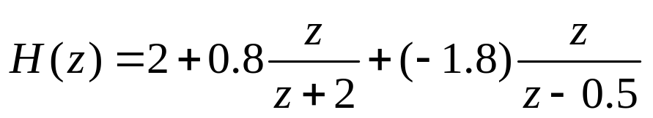
where
thus
The unit-pulse response h(n) is the inverse z-transform of H(z), so

Slide 20
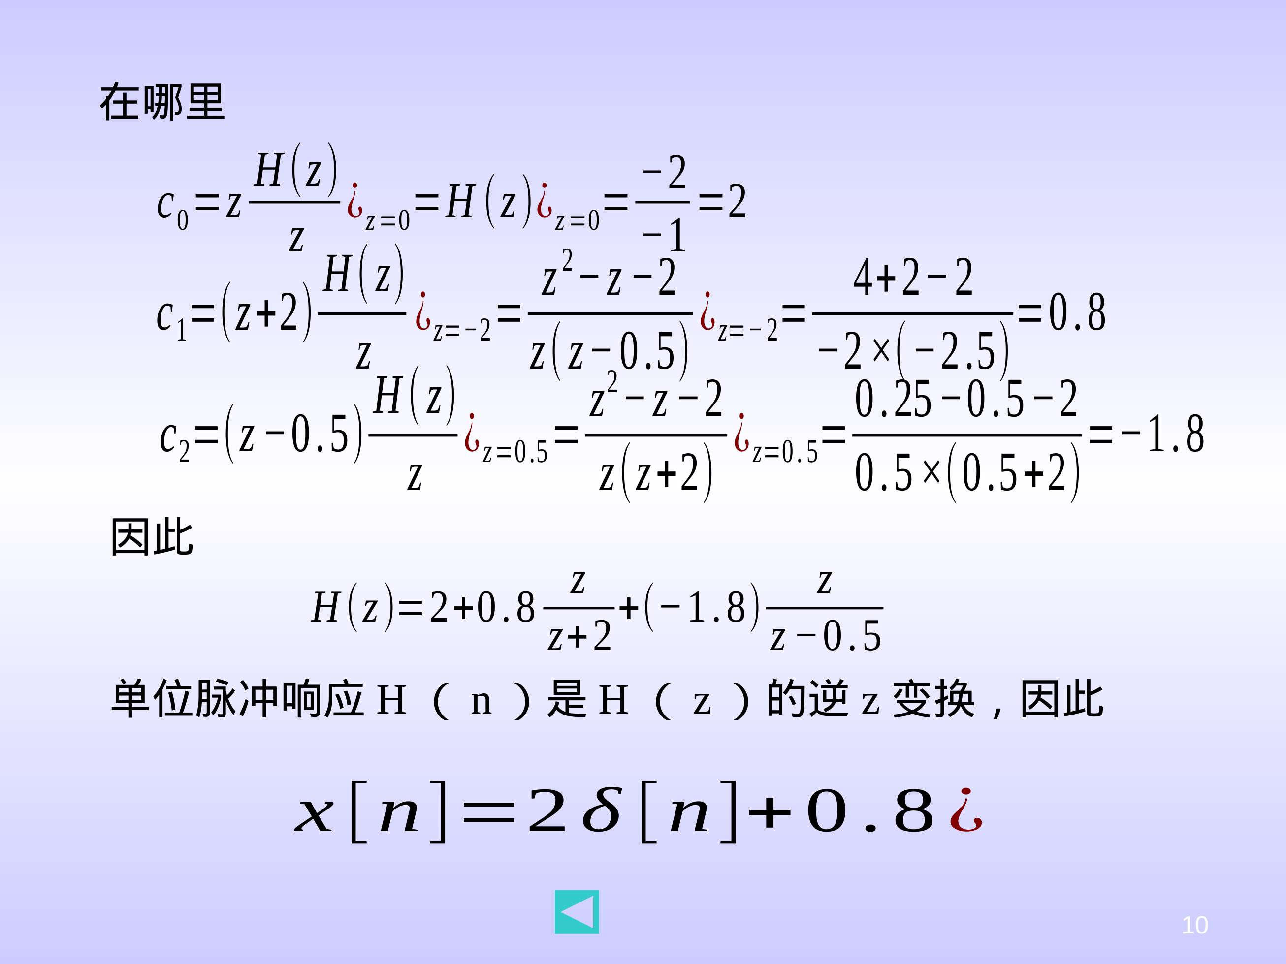
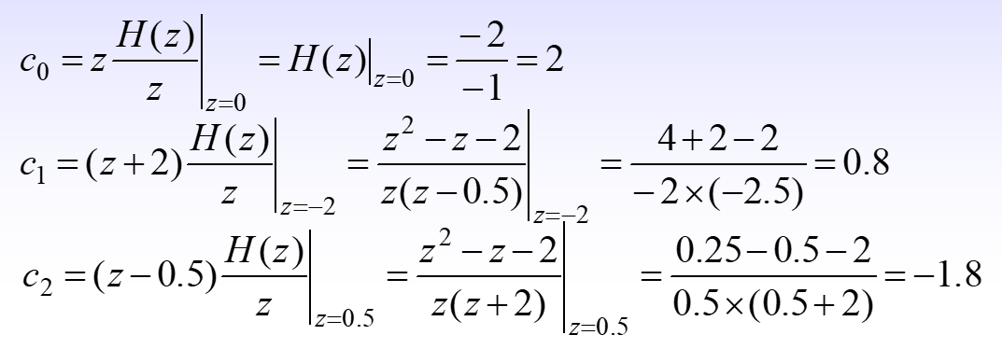


Slide 21
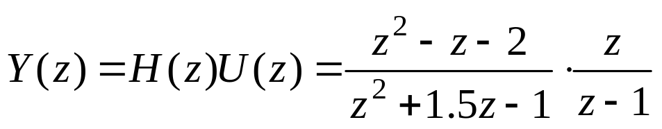
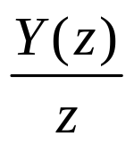
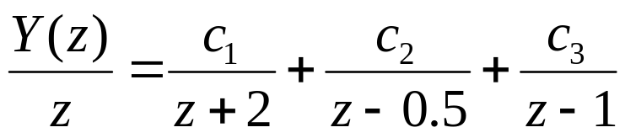
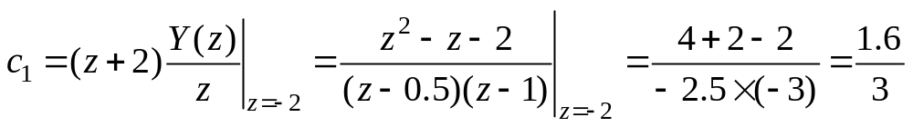
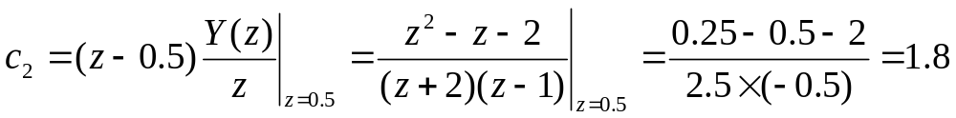
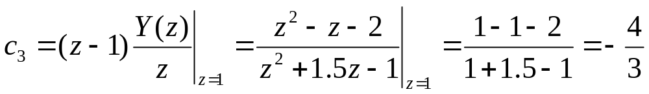
5.4(b) The z-transform Y(z) of the step response y[n] is
Then expanding gives:
where

Slide 22
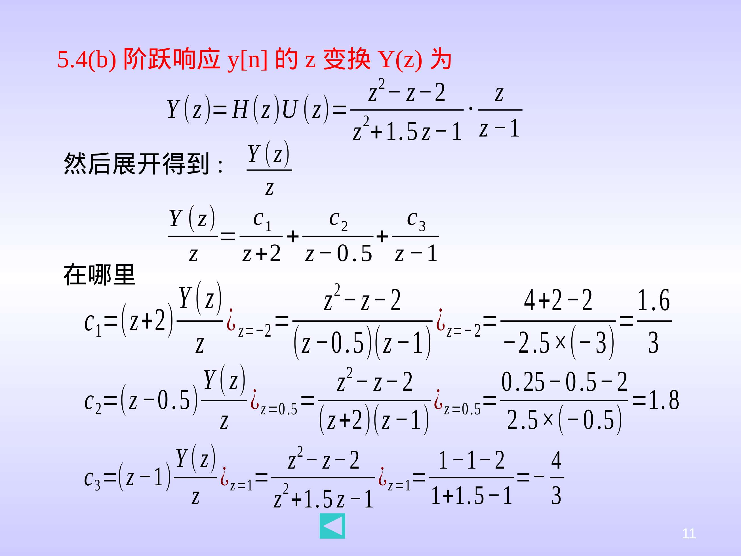
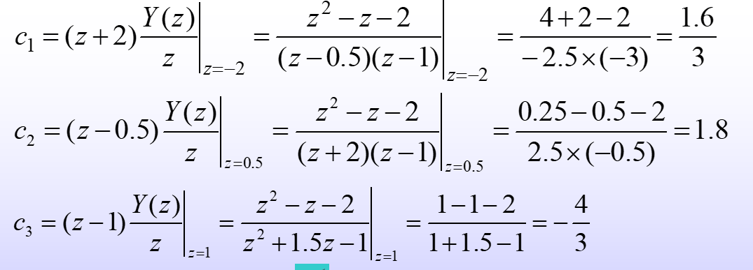

Slide 23
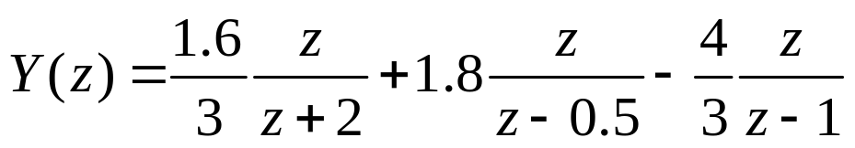
thus
Then the step response y[n] is the inverse z-transform of Y(z), i.e.,
5.4(c) Because the pole p₁ =−2 of H(z) is located out of the unit disk of the complex plane, the system is unstable

Slide 24
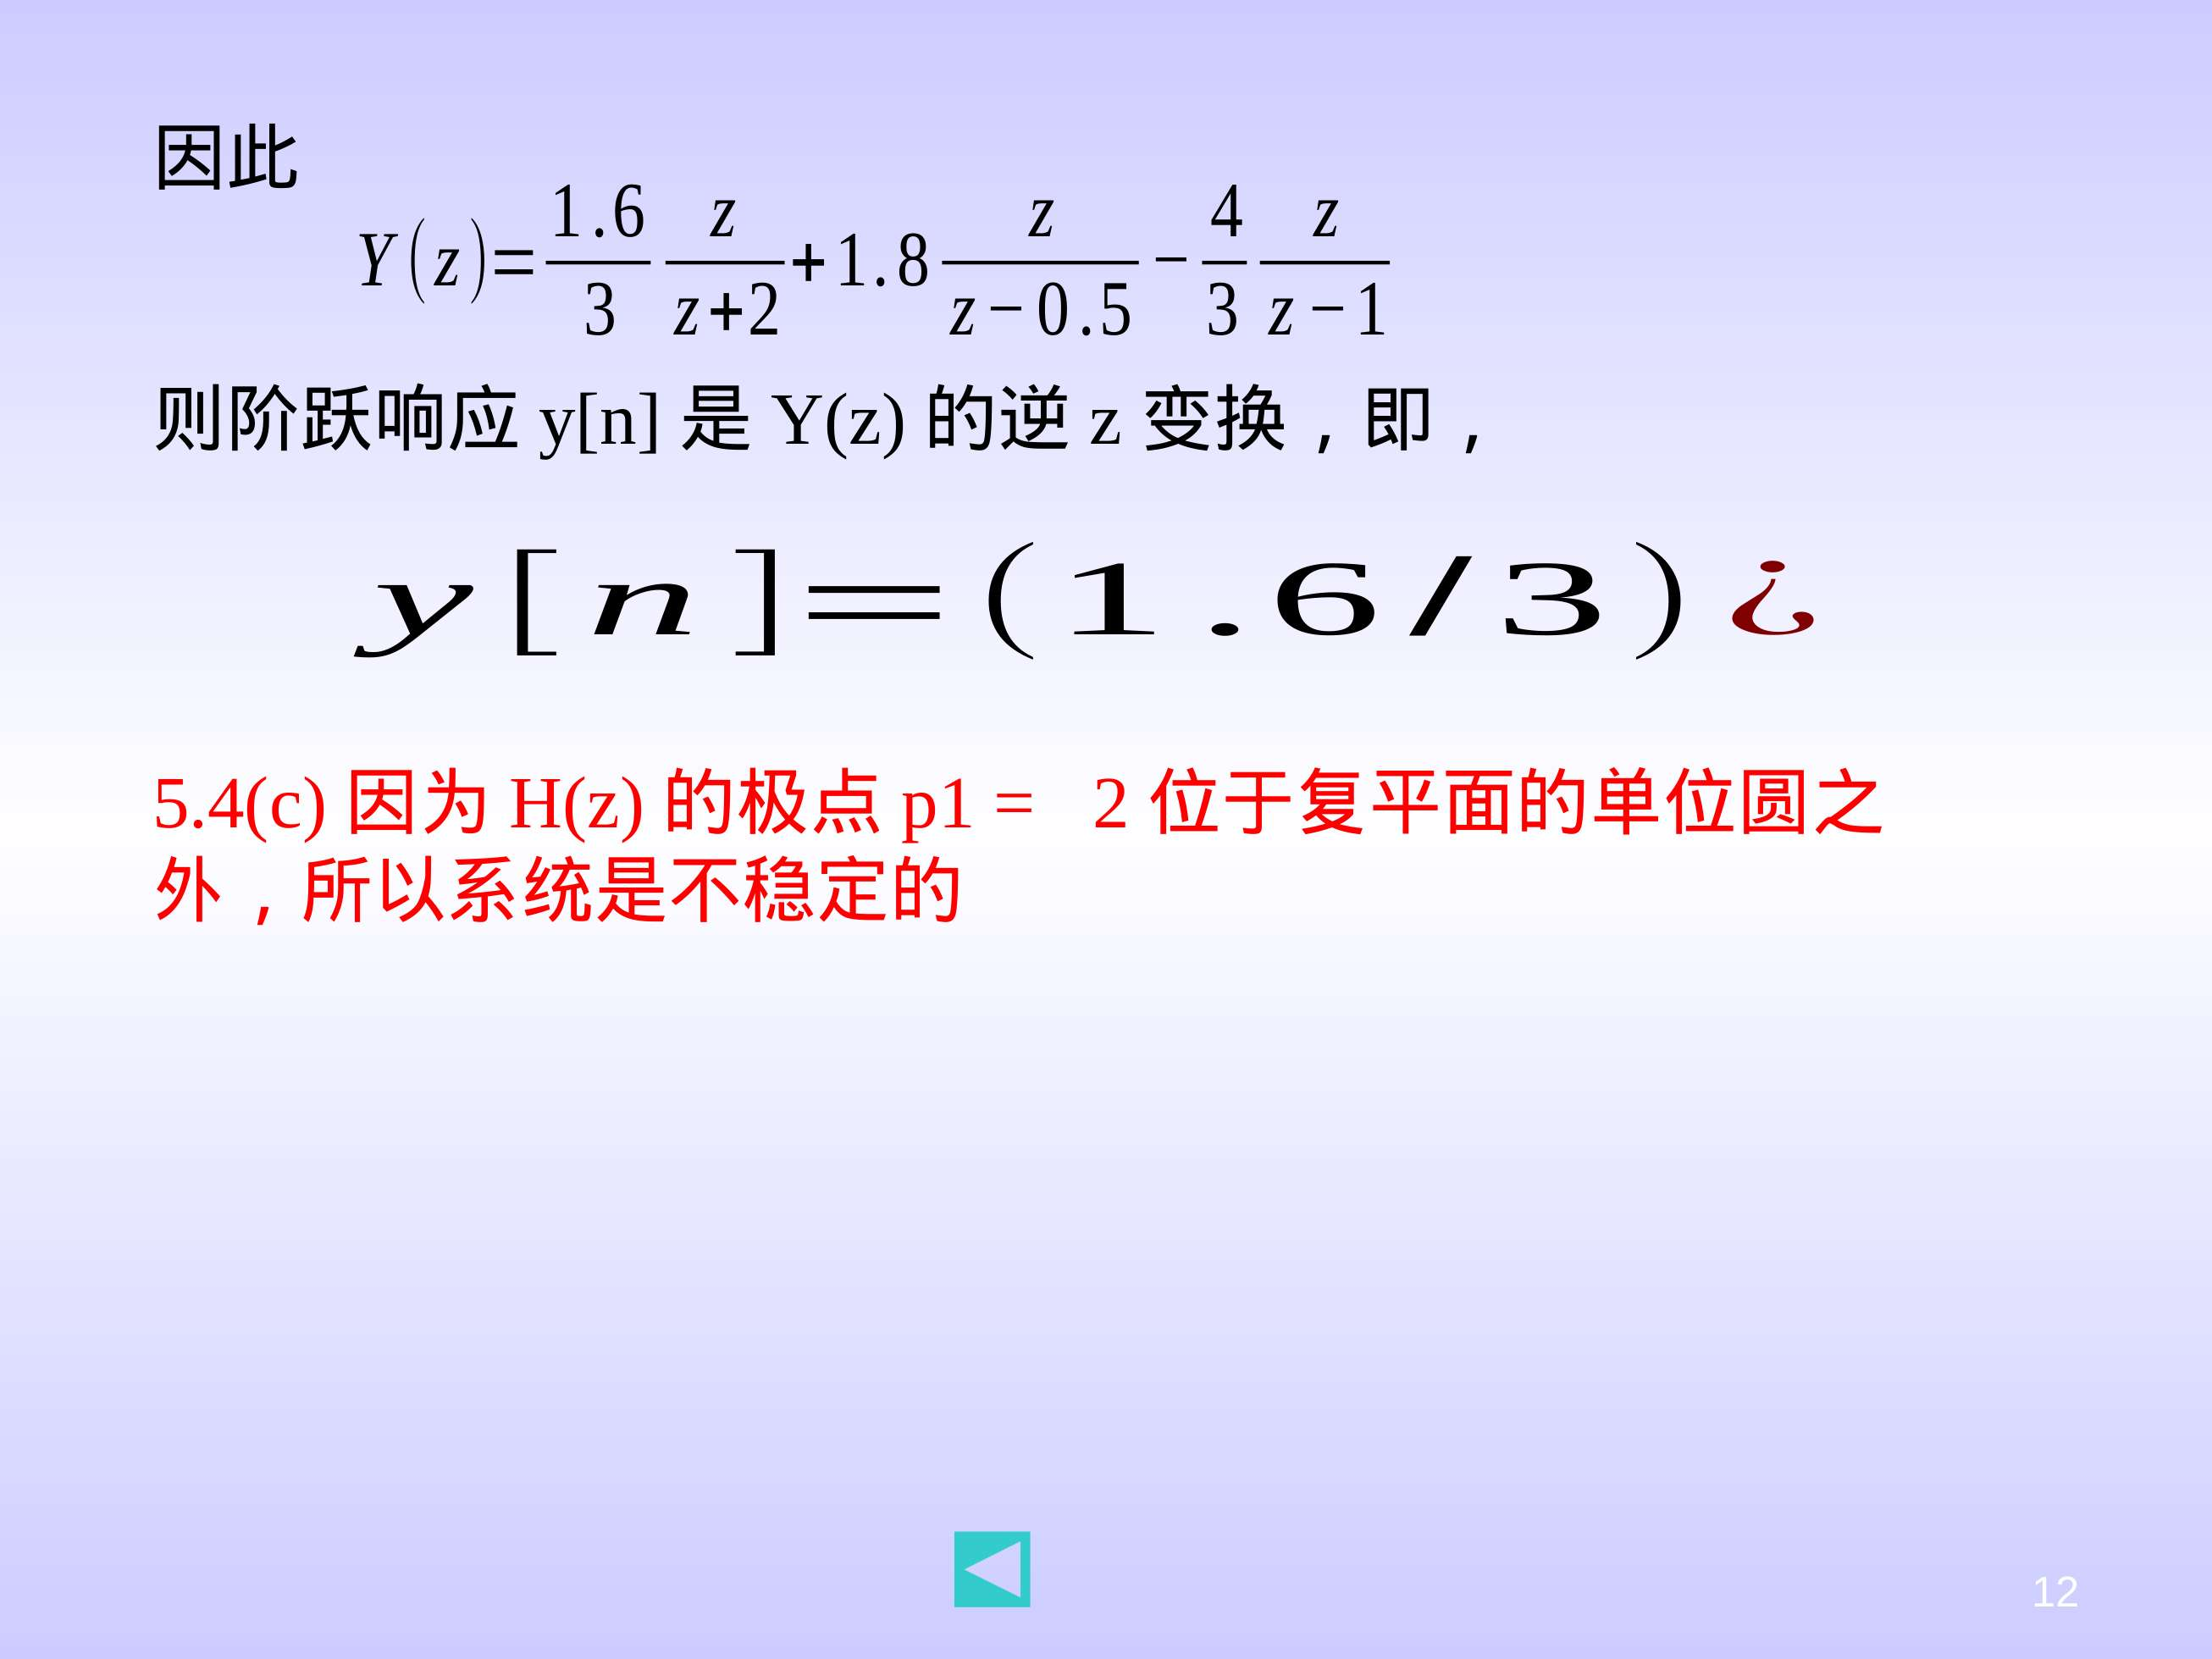
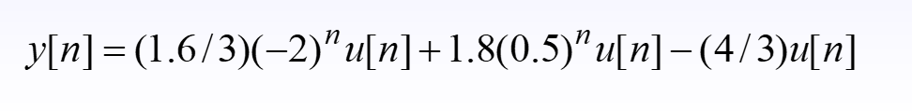

Slide 25
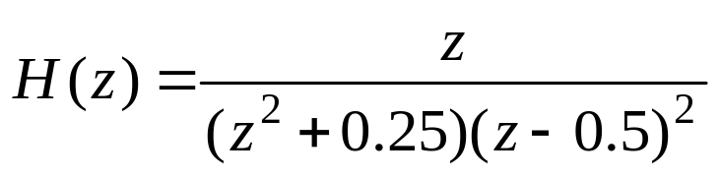
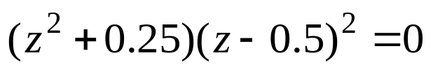
5.5 A linear time-invariant discrete-time system has transfer function
(a) Determine if the system is stable, marginally stable, or unstable.
(b) Use MATLAB to plot the frequency response curves of the system.
Solution:
5.5(a) Let , so the poles of H(z) is:
Because all the poles lie in the open unit disk of the complex plane, the system is stable

Slide 26
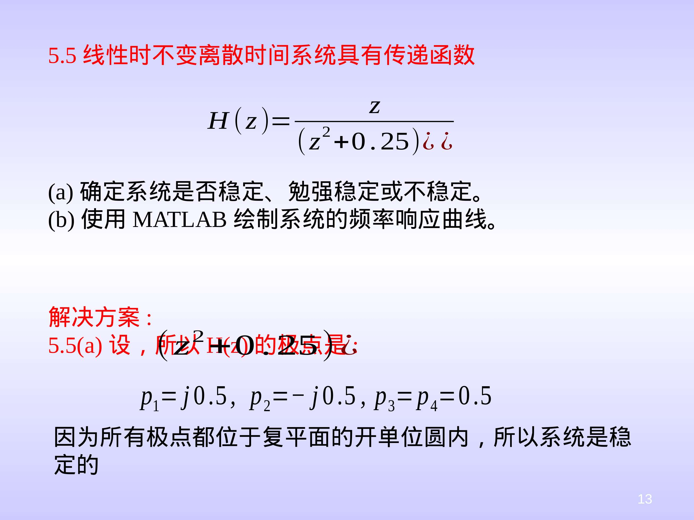
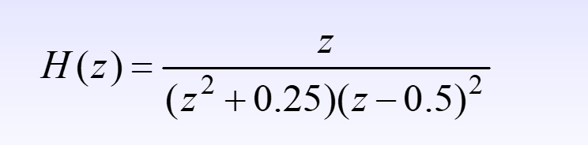


Slide 27
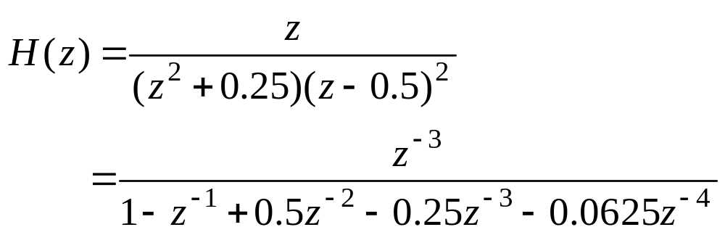
5.5 (b)
num=[0 0 0 1 0];
den=[1 -1 0.5 -0.25 0.0625];
OMEGA= - pi:pi/150:pi;
H=freqz(num,den,OMEGA);
subplot(211),plot(OMEGA,abs(H));
subplot(212),plot(OMEGA,180/pi*angle(H))

Slide 28




Slide 29

5.5 (b)
num=[0 0 0 1 0];
den=[1 -1 0.5 -0.25 0.0625];
OMEGA= - pi:pi/150:pi;
H=freqz(num,den,OMEGA);
subplot(211),plot(OMEGA,abs(H));
subplot(212),plot(OMEGA,180/pi*angle(H))

Slide 30



